Slide 1
INTERNSHIP STUDIO
ETHICAL HACKING TASK -1

Slide 2
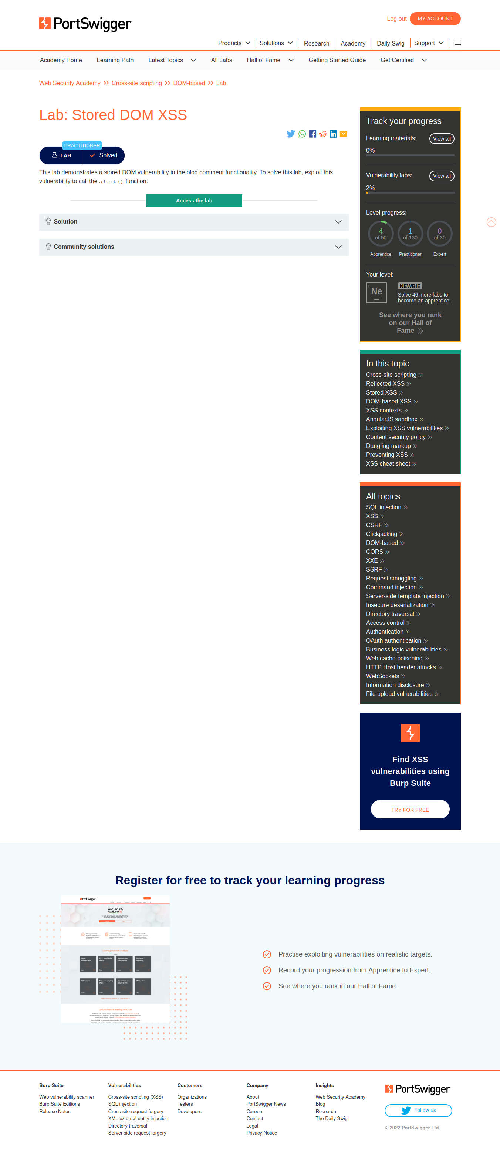

Slide 3


Slide 4
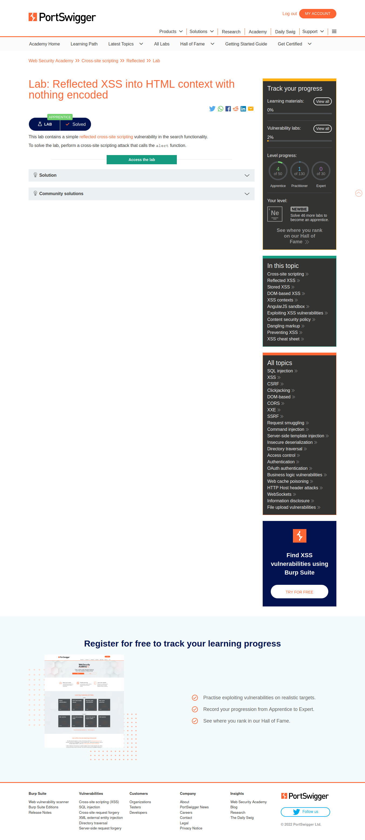

Slide 5
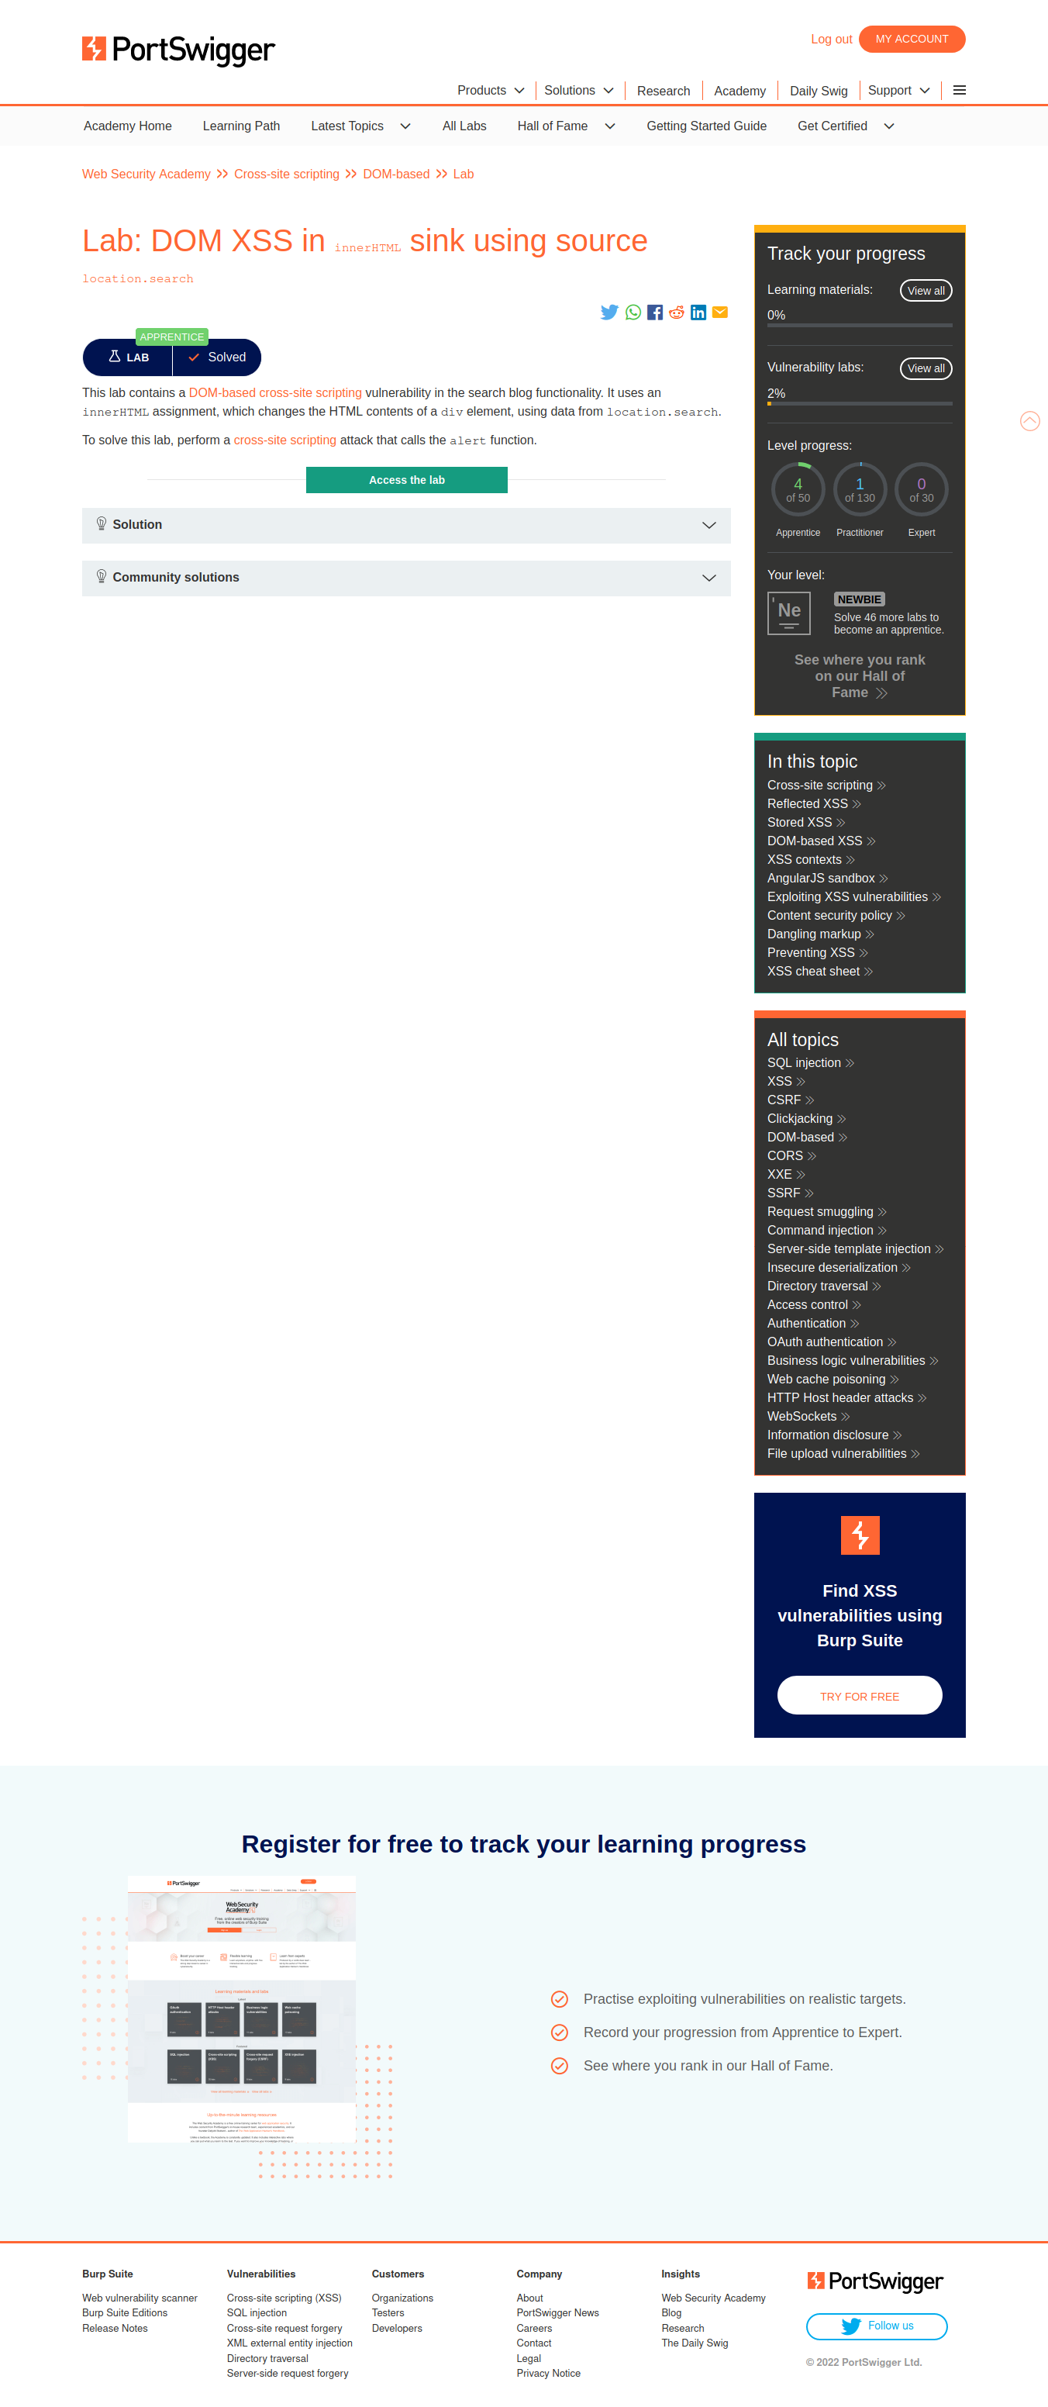

Slide 6
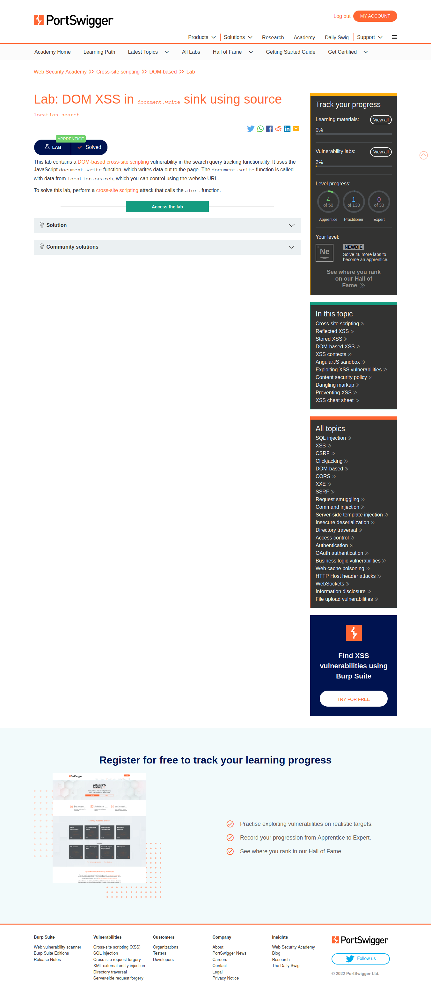

Slide 7
REPORT:
I HAVE DONE 5 LAB ACTIVITIES IN “PORTSWIGGER LAB”.
ALL THE SCREENSHOTS ARE PROOF FOR MY WORK.
POERSWIGGER LAB CAN BE USED USING “BURPSUITE” AND WHEN THE INTERCEPT IS “ON”.
CROSS SITE SCRIPTING VULNERABILITIES ARE IDENTIFIED WITH THE HTML TAG : <sciprt>alert(1)</script>.

